Slide 1

CRYPTOCURRENCY AND
VALUATIONS
ALY 6070 : COMMUNICATION AND VISUALIZATION FOR DATA ANALYTICS

Slide 2

INTRODUCTION
This study aims to demonstrate the application of Principal Component Analysis (PCA) in R for feature reduction and determining the optimal number of components in a given dataset.
The dataset used in this study is the Bitcoin cryptocurrency network data from Coin Metrics, which contains multiple variables related to the Bitcoin network.
PCA is employed to transform the original variables into a smaller set of uncorrelated variables, providing insights into the underlying structure of the data and simplifying subsequent analyses.
The optimal number of components is determined by visualizing the variance explained by each component and selecting the number of components that capture sufficient variance.
The results of this study provide a practical example of how PCA can be used in R to perform feature reduction and enhance the efficiency and interpretability of subsequent analyses in large datasets.

Slide 3
DATASET DESCRIPTION
Exploring the Dataset

Slide 4
2994 Rows and 10 Columns
No Missing Values
Real Time Data
That’s a lot of data
The cleaner, the better
From Kaggle

Slide 5
VARIABLE DESCRIPTION
Name | Crypto Name
Symbol | Crypto Symbol
Date | Date of observation
High | Highest price on the given day
Low | Lowest price on the given day
Open | Opening price on the given day
Close | Closing price on the given day
Volume | Volume of transactions on the given day
Marketcap | Market capitalization in USD

Slide 6
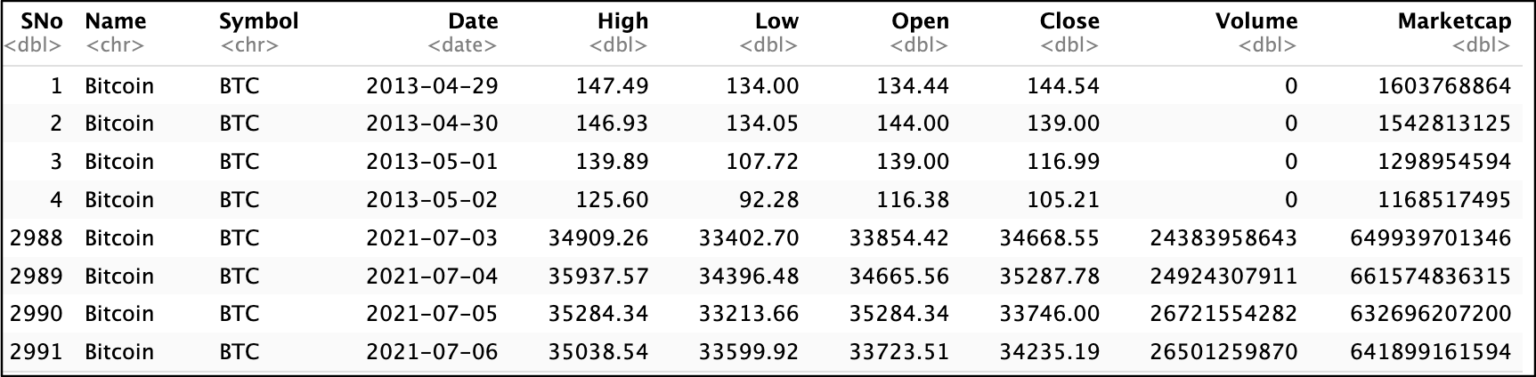
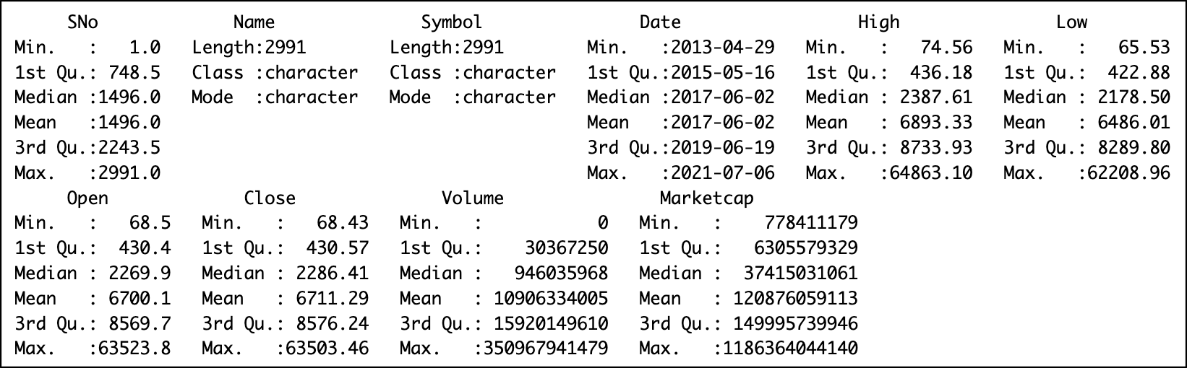
The headtail() function was used to display the first and last four rows, as shown in the table above. A summary of the dataset was also displayed to gain a better understanding of the variables.

Slide 7
Explore Data features with different types of graphs in R

Slide 8
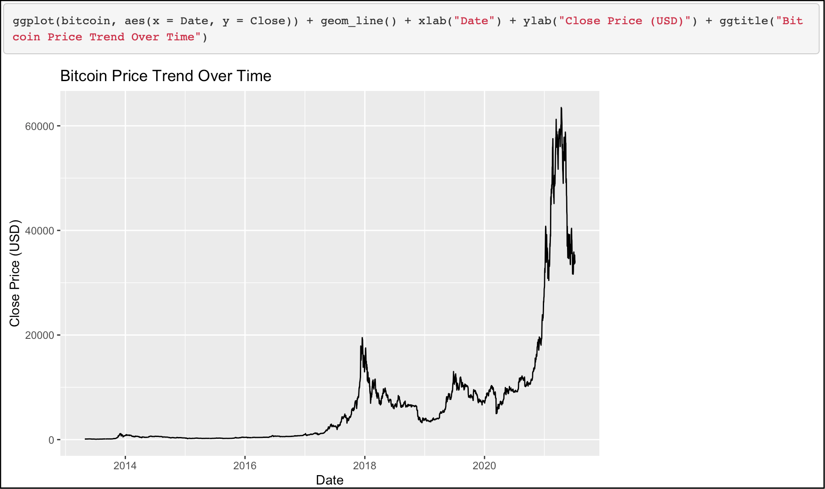
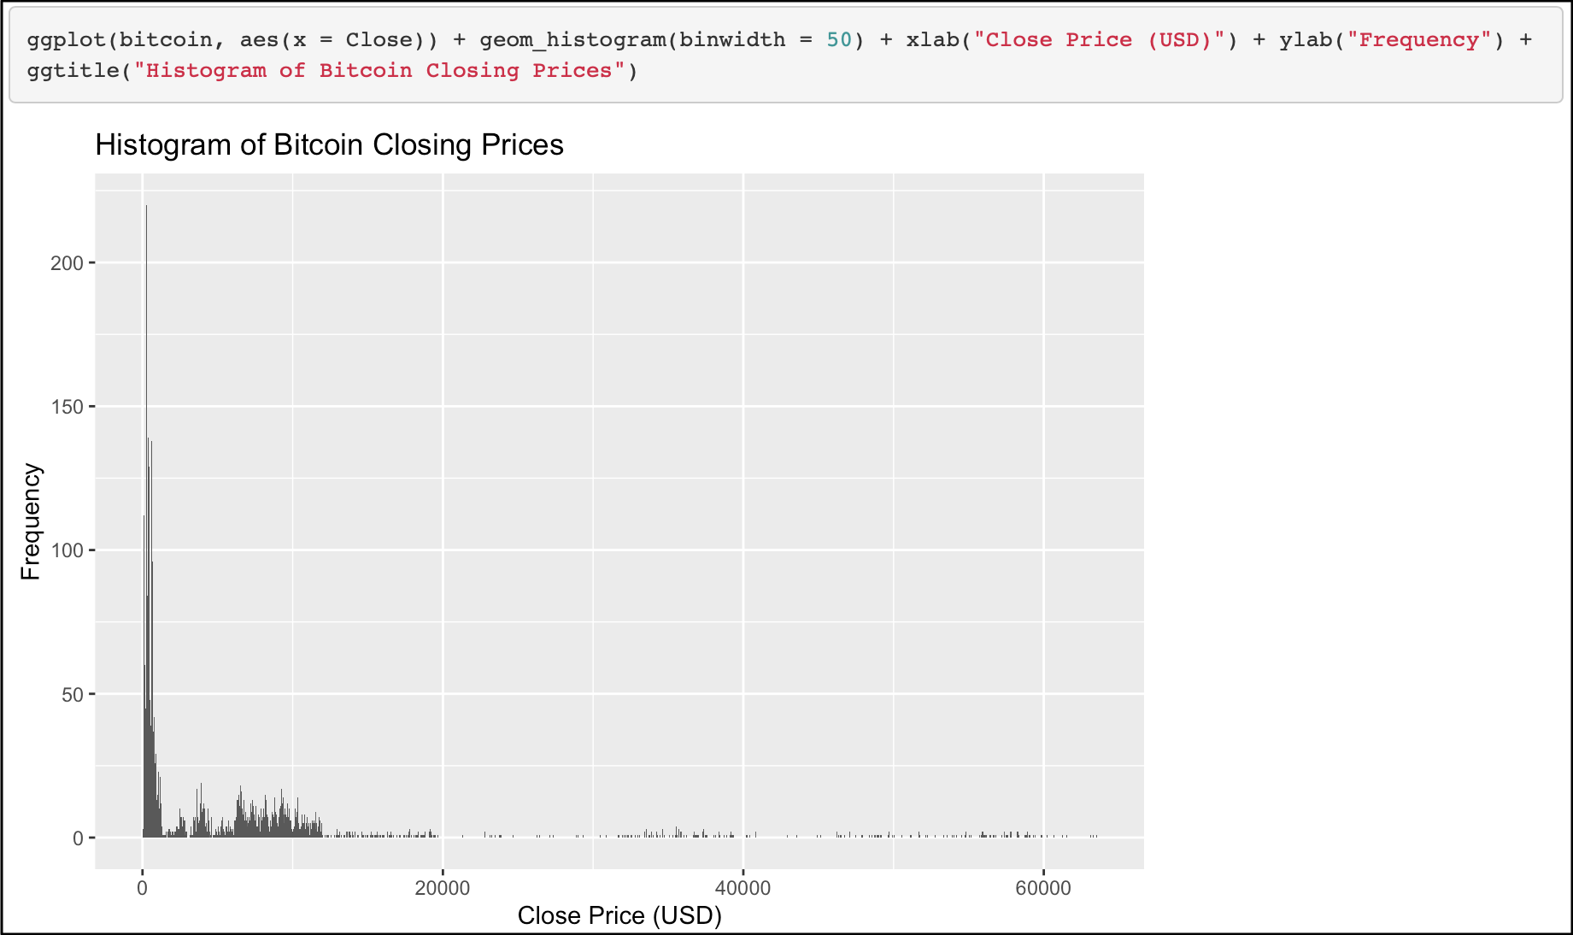
Histogram - to show the distribution of Bitcoin closing prices

Slide 9
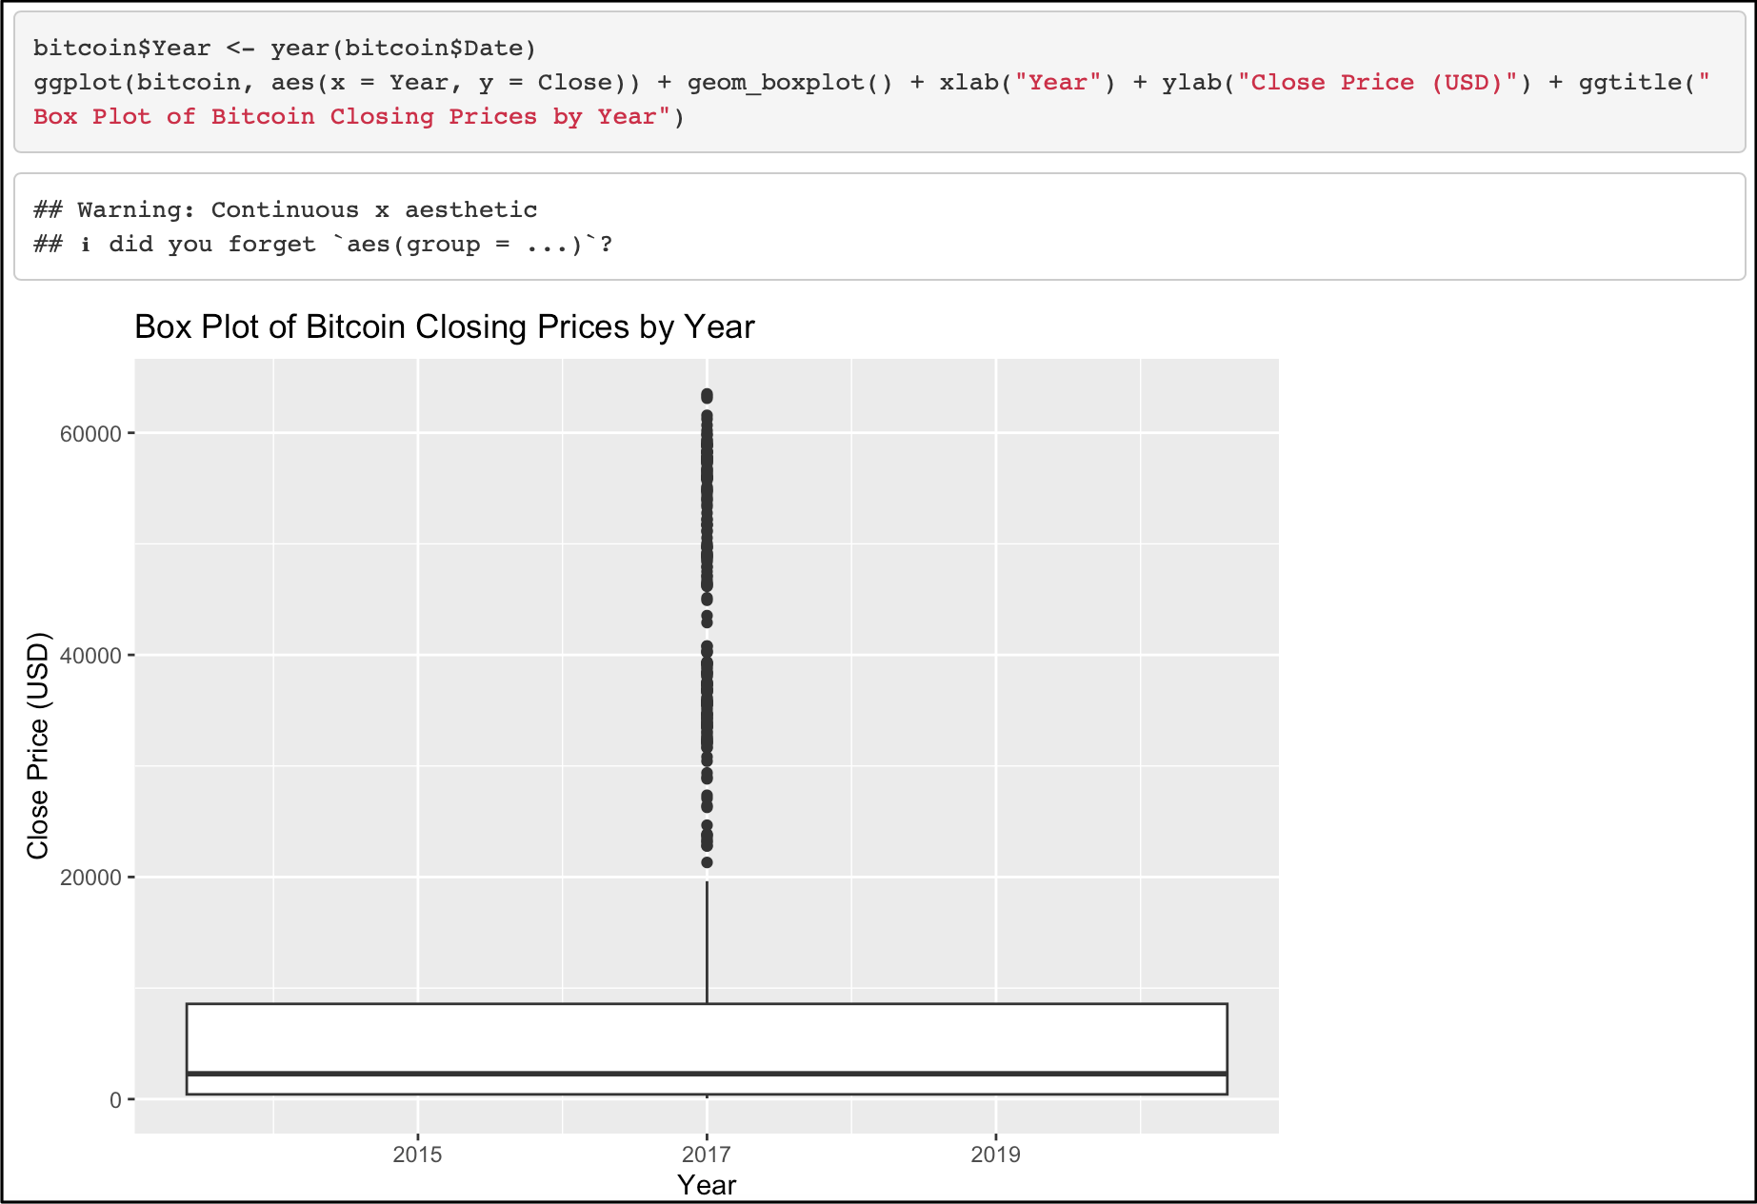
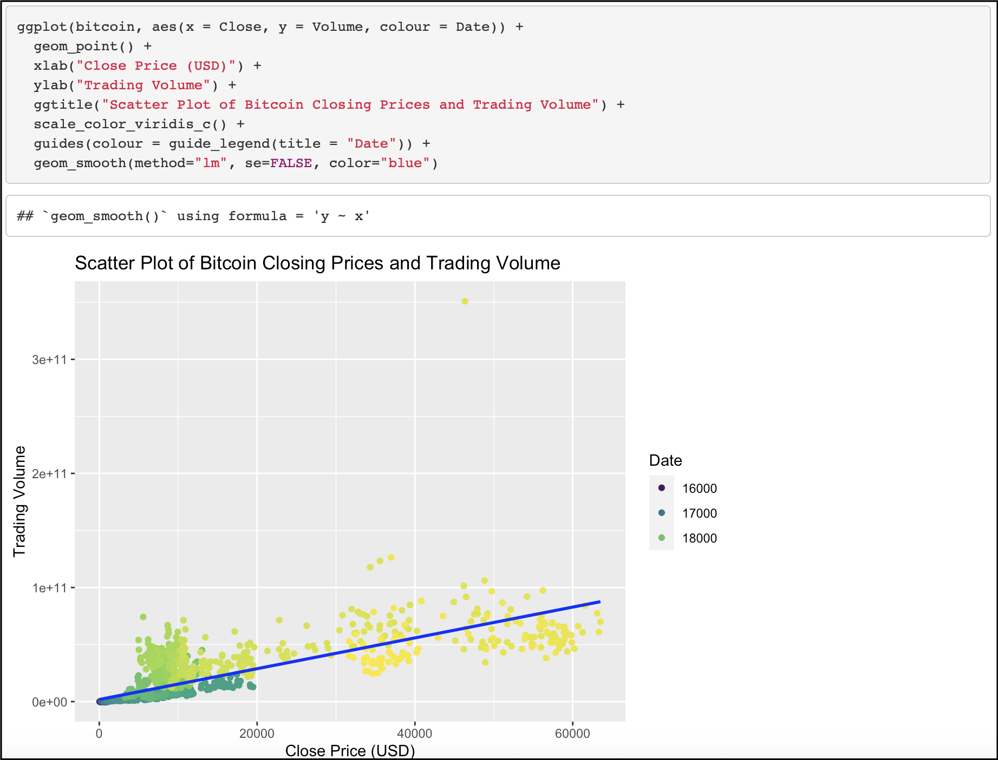
Box Plot - To show the distribution of Bitcoin closing prices by year
Scatter Plot - To show the relationship between Bitcoin closing prices and trading volume

Slide 10
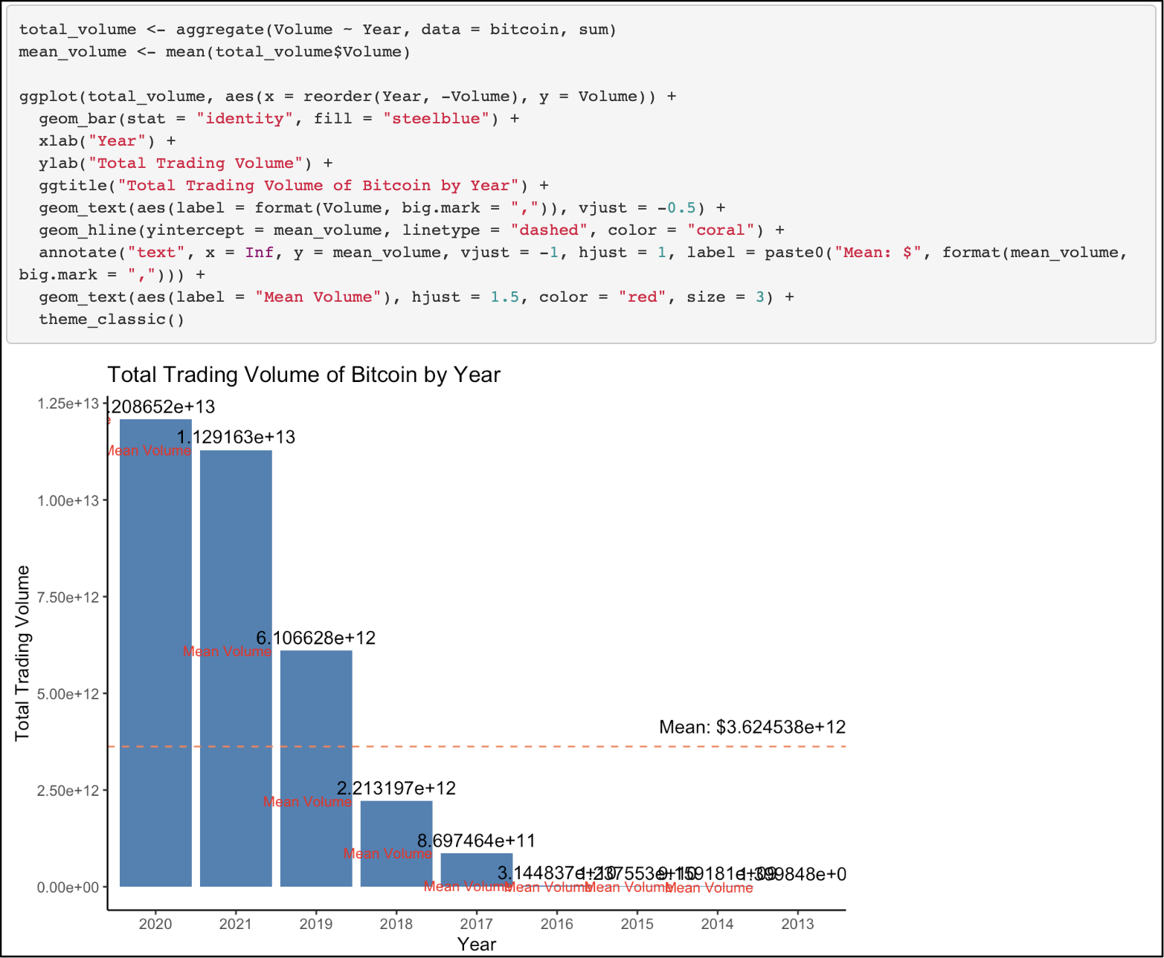
Bar chart
To show the total trading volume of Bitcoin by year

Slide 11
Running a PCA approach in R to do a feature reduction.

Slide 12
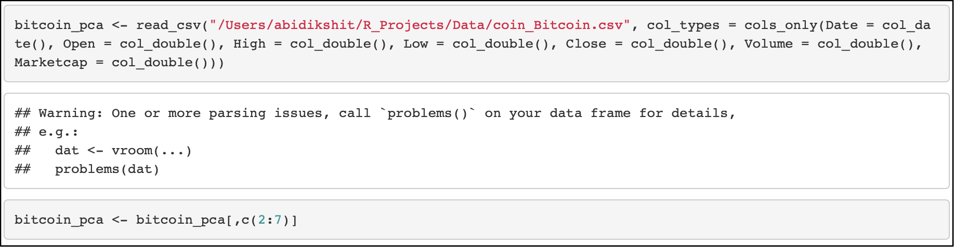
Let’s run a Principal Component Analysis (PCA) approach in R to do a feature reduction on the cryptocurrency price history dataset. First, let’s load the dataset and prepare it for PCA. We will use the dataset, and select only the Open, High, Low, Close, Volume, and Market cap columns:
Lkrn lknv4f4
Next, we will scale the data to have zero mean and unit variance:Now, we can run the PCA using the prcomp() function:

Slide 13
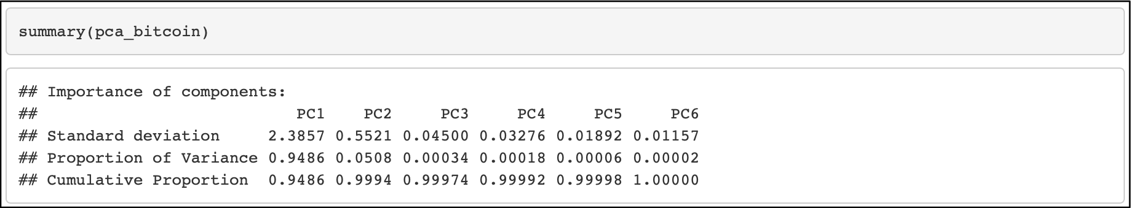
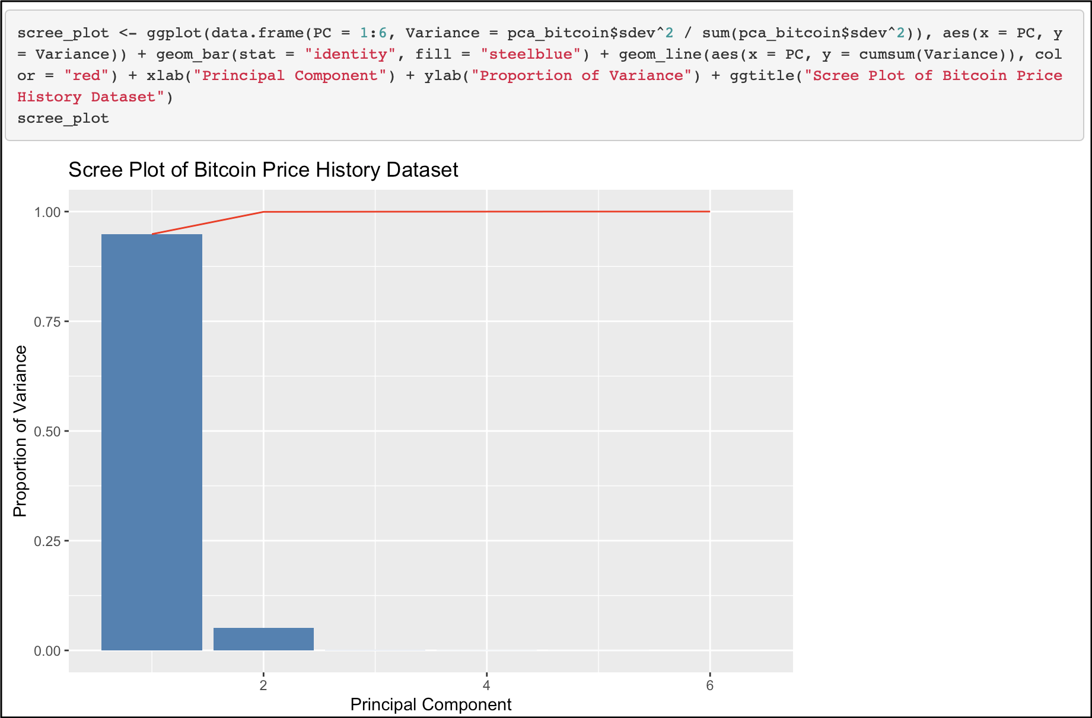
We can now explore the results of the PCA, starting with the summary of the PCA object:
This shows us that the first principal component (PC1) explains 94.86% of the variance in the data, while the second principal component (PC2) explains 5.08% of the variance, and so on.
We can also plot a scree plot to visualize the proportion of variance explained by each principal component:

Slide 14
Deciding on the best components based on the PCA visualization.

Slide 15
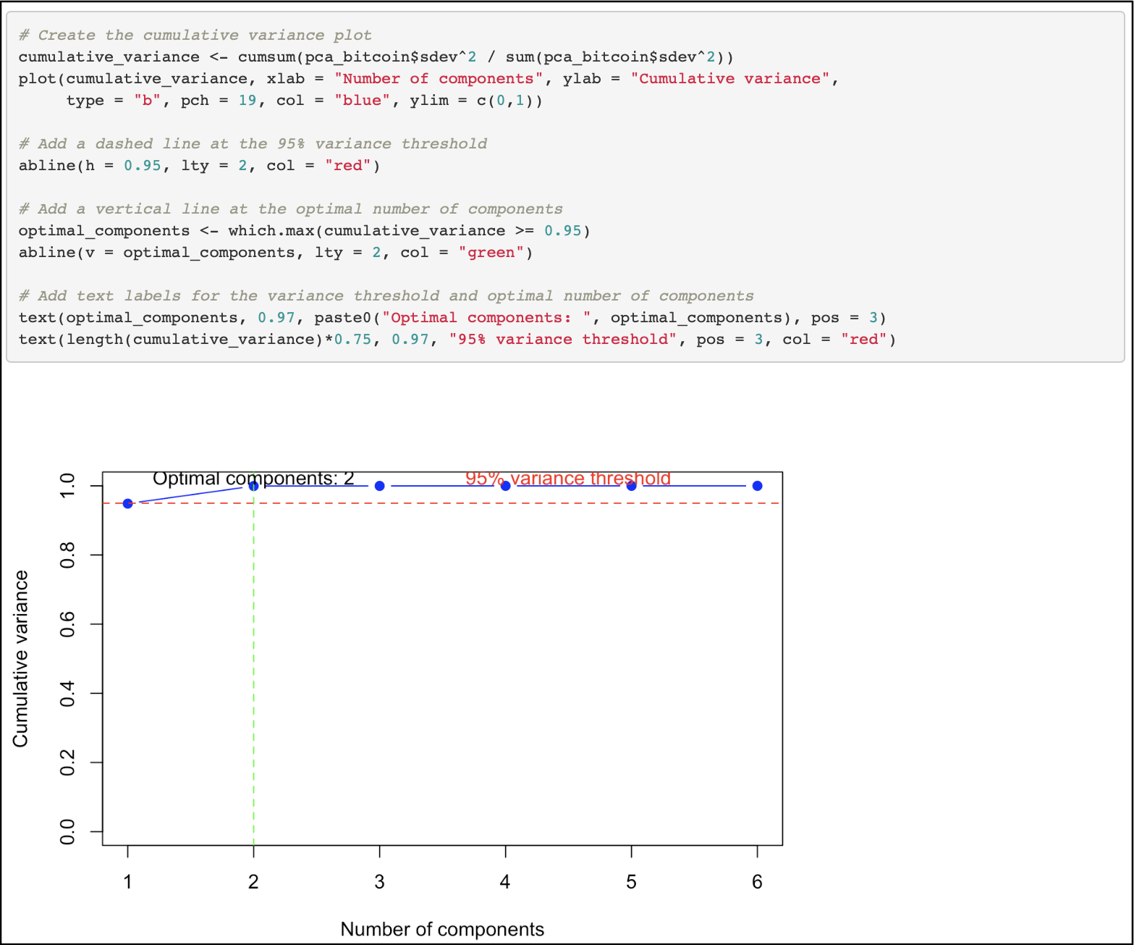
Finally, we can extract the principal components using the predict() function:
We can then use these principal components for further analysis or modeling
Plot the cumulative variance plot.

Slide 16
The cumulative variance plot shows the cumulative proportion of variance explained by each principal component in the Bitcoin Price History dataset. The x-axis represents the number of principal components, while the y-axis represents the cumulative proportion of variance.
As we can see from the blue line, which shows the cumulative proportion of variance explained by each additional principal component, the blue line in the cumulative variance plot at first it was increasing and then stays steady after the second component.
The red dashed line indicates the 95% variance threshold, which is commonly used as a cutoff for the number of principal components to retain in a PCA analysis.
The green dashed line shows the optimal number of components, which is the number of components at or just below the 95% variance threshold and intersects with the plot at the second component.
Overall, As the blue line in the cumulative variance plot stays steady after the second component, and that the green dashed line intersects with the plot at the second component.
In this case, choosing two components would explain 95% of the variance in the data, which is a good amount of the total variance. Therefore, using two components may be a reasonable choice for dimensionality reduction or further analysis. So, the optimal number of components would be 2.

Slide 17
REFERENCES
[1] Silge, M. K. A. J. n.d. 16 Dimensionality Reduction | Tidy Modeling with r. https://www.tmwr.org/dimensionality.html.
[2] Wood, R. 2021, December 14. Learn Principal Component Analysis in r - Towards Data Science. https://towardsdatascience.com/learn-principle-component-analysis-in-r-ddba7c9b1064.

